Slide 1

Vector Semantics and Embeddings

Slide 2
Contents
Vector Semantics
Word Embeddings
Distributed Representation
Training Word Embeddings
Semantic Relationships in Embeddings
Limitations
Contextualized Word Embeddings

Slide 3
Vector Semantics
Concept
  Vector semantics represents words or phrases as numerical vectors in a high-dimensional space to capture their semantic relationships and meanings.
  This involves mapping words to points in the vector space, enabling mathematical manipulation and analysis based on semantic similarities.
Capturing Semantic Relationships
  Vector semantics aims to capture both syntactic and semantic relationships among words.
  Similar or contextually linked words are depicted as vectors positioned closely in the vector space.
  Vectors' proximity and orientation convey word relationships and meanings, facilitating algorithms to measure semantic similarities and execute tasks such as word analogy and similarity computations.

Slide 4
Word Embeddings
Concept
  Word embeddings, derived from vector semantics, are compact, continuous-value word representations that maintain semantic relationships. Learned from extensive text data via techniques like neural networks, word embeddings ensure analogous words share akin vector forms.
  Word embeddings excel at grasping intricate word connections like synonyms, antonyms, context, and analogies. A prime instance involves the vector for "king" - "man" + "woman" closely aligning with the vector for "queen" in a proficiently trained embedding space.
  Leveraging word embeddings, natural language processing (NLP) algorithms enhance diverse tasks like text classification, sentiment analysis, and machine translation. These embeddings substantially elevate computers' grasp of human language, resulting in enhanced precision and effectiveness across NLP applications.

Slide 5
Word Embeddings
Effectiveness in Natural Language Processing Tasks
  Text Classification: Word embeddings help models understand the meanings and context of words, improving the accuracy of text classification tasks like sentiment analysis, topic categorization, and spam detection.
  Machine Translation: By learning word embeddings from multilingual text, models can better understand how words in different languages relate to each other, leading to improved translation accuracy.
  Named Entity Recognition (NER): Word embeddings aid in identifying named entities (names of people, places, organizations) by recognizing patterns and contexts associated with them.

Slide 6
Word Embeddings
Effectiveness in Natural Language Processing Tasks
  Information Retrieval: Word embeddings enable more relevant search results by understanding synonyms, context, and relationships between query terms and document content.
  Question Answering: Models can use word embeddings to better understand questions and find relevant passages or answers by identifying the semantic meanings within the text.
  Text Similarity and Clustering: Word embeddings help measure semantic similarity between texts and cluster similar documents together.

Slide 7
Word Embeddings
Effectiveness in Natural Language Processing Tasks
  Natural Language Understanding: In tasks like sentiment analysis, emotion detection, and intent recognition, word embeddings enable models to capture nuanced linguistic patterns.
  Word Analogy Tasks: Word embeddings can solve analogy tasks like "king - man + woman = queen" by manipulating the vectors to preserve semantic relationships.
  Text Generation: Word embeddings enhance the quality and coherence of generated text by ensuring that words chosen by the model fit contextually.
  Speech Recognition: In automatic speech recognition, word embeddings assist in understanding the spoken words and their semantic meanings.

Slide 8
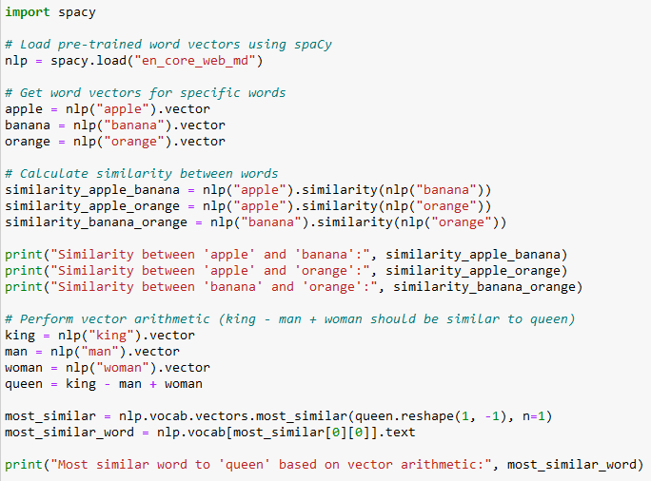
Example
In this example:
We use the spaCy library to load pre-trained word vectors for English words (en_core_web_md).
We calculate the similarity between words "apple," "banana," and "orange" using the .similarity() method.
We demonstrate vector arithmetic by finding a word similar to "king - man + woman," which should be similar to "queen."
When running this code, it will output the similarity scores between words and the word most similar to "queen" based on vector arithmetic

Slide 9
Distributed Representation
Concept
  Distributed representation, or distributed semantics, is central to word embeddings.
  This concept represents words as vectors in a multi-dimensional space.
  Each vector dimension encapsulates a unique semantic trait.
  Here, a word's meaning stems from interactions with other words, fostering nuanced and contextually profound comprehension.

Slide 10
Distributed Representation
Encoding Semantic Features in Vector Dimensions
  In word embeddings, each dimension of a vector is dedicated to encoding a particular semantic feature.
  These features might include things like gender, tense, sentiment, context, and more.
  Instead of representing a word as a binary presence-absence signal (as in one-hot encodings), distributed representation assigns values to multiple dimensions, allowing words to capture a combination of semantic attributes.

Slide 11
Distributed Representation
Illustrating Similar Words in the Embedding Space
  Consider a hypothetical two-dimensional vector space for illustration purposes. In reality, word embeddings typically have hundreds of dimensions. Let's say we're working with a small vocabulary of animals, and we've learned the following word embeddings:
    "cat": [0.5, 0.7]
    "dog": [0.4, 0.6]
    "elephant": [0.2, 0.1]
    "tiger": [0.45, 0.65]

Slide 12
Distributed Representation
Illustrating Similar Words in the Embedding Space
  In this two-dimensional space, vectors are visualized as points, showing close proximity for similar animals like "cat" and "dog," distinguishing them from "elephant."
  Distances and angles between vectors reflect word relationships. Similar words have close vectors; distinct ones are distant. Word embeddings' distributed nature captures intricate semantics.
  Real-world embeddings span hundreds of dimensions, capturing vast nuances. This vital distributed representation enhances natural language processing by refining word meanings and relationships..

Slide 13
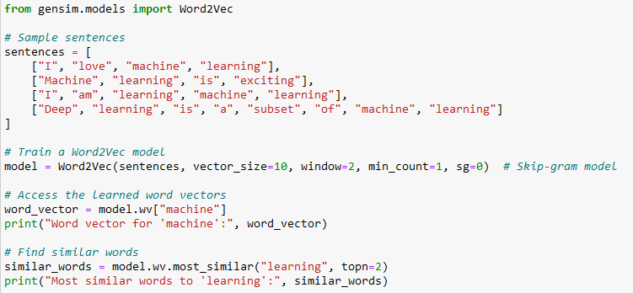
Example
In this example
We use the Word2Vec model from gensim to learn word embeddings from a small dataset of sentences.
The parameters vector_size define the dimensionality of the word vectors, window sets the maximum distance between the current and predicted word, and min_count sets the minimum number of occurrences of a word to consider for training.
We use the Skip-gram model (sg=0) to predict context words from the target word.
We access the learned word vectors using the .wv attribute of the trained model.
We find the word vector for the word "machine" and find the most similar words to "learning" based on the learned embeddings.

Slide 14
Training Word Embeddings
Techniques for Training Word Embeddings
  Word2Vec
    This method learns embeddings by predicting context words from a target word (Skip-gram) or predicting a target word from context (Continuous Bag of Words, CBOW).
    Through text iterations, it enhances embeddings, adept at semantic relations and analogies.
  GloVe (Global Vectors for Word Representation)
    GloVe learns embeddings from corpus-wide word co-occurrence stats.
    It factorizes a co-occurrence matrix into vectors, aiming for both local (contextual) and global (corpus-wide) relationships.
  FastText:
    Extending Word2Vec, FastText views words as character n-gram sets.
    This enables embeddings for new words and subword insights.
    Words can be represented by summing their character n-grams.

Slide 15
Training Word Embeddings
Iterative Optimization Process
  Initialization
    Initialize word vectors randomly or with pre-trained values
  Objective Function
  Gradient Descent
  Negative Sampling (Word2Vec)
  Updating Vectors
  Convergence
  Extracting Word Embeddings

Slide 16
Training Word Embeddings
Iterative Optimization Process
  Initialization
  Objective Function
    Define an objective function that quantifies the quality of the embeddings. For Word2Vec, the objective function measures how well the model predicts context words from target words (or vice versa).
  Gradient Descent
  Negative Sampling (Word2Vec)
  Updating Vectors
  Convergence
  Extracting Word Embeddings

Slide 17
Training Word Embeddings
Iterative Optimization Process
  Initialization
  Objective Function
  Gradient Descent
    Use optimization techniques like gradient descent to update the word vectors iteratively. The goal is to minimize the difference between predicted and actual words in the context.
  Negative Sampling (Word2Vec)
  Updating Vectors
  Convergence
  Extracting Word Embeddings

Slide 18
Training Word Embeddings
Iterative Optimization Process
  Initialization
  Objective Function
  Gradient Descent
  Negative Sampling (Word2Vec)
    To avoid updating weights for all words in the vocabulary (which can be computationally expensive), Word2Vec uses negative sampling. It selects a small number of negative samples (words not in the context) for each positive sample and updates their weights.
  Updating Vectors
  Convergence
  Extracting Word Embeddings

Slide 19
Training Word Embeddings
Iterative Optimization Process
  Initialization
  Objective Function
  Gradient Descent
  Negative Sampling (Word2Vec)
  Updating Vectors
    The optimization process adjusts word vectors to improve the model's ability to predict context words. Similar words (based on co-occurrence) end up having similar vectors.
  Convergence
  Extracting Word Embeddings

Slide 20
Training Word Embeddings
Iterative Optimization Process
  Initialization
  Objective Function
  Gradient Descent
  Negative Sampling (Word2Vec)
  Updating Vectors
  Convergence
    Repeat the optimization process for multiple epochs until the model's performance stabilizes or converges.
  Extracting Word Embeddings

Slide 21
Training Word Embeddings
Iterative Optimization Process
  Initialization
  Objective Function
  Gradient Descent
  Negative Sampling (Word2Vec)
  Updating Vectors
  Convergence
  Extracting Word Embeddings
    Once training is complete, the learned vectors represent word embeddings. These vectors can be used for various NLP tasks.

Slide 22
Semantic Relationships in Embeddings
Word embeddings capture semantic relationships by representing words as dense vectors in a high-dimensional space.
The key idea is that words with similar meanings or contextual usage are represented by vectors that are close to each other in this space.
This closeness enables word embeddings to capture various types of semantic relationships and analogies.

Slide 23
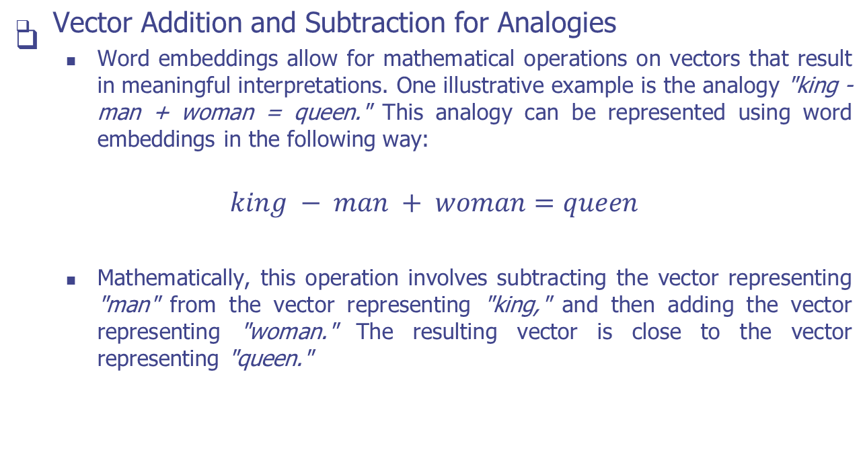
Semantic Relationships in Embeddings

Slide 24
Semantic Relationships in Embeddings
Similar Words in the Vector Space
  In the embedding space, words with similar meanings or contexts are represented by vectors that are close together.
  This proximity reflects the semantic similarity between the words.
  For example:
    The vectors for "cat" and "dog" are closer to each other than to the vector for "elephant," indicating their semantic similarity.
    The vectors for synonyms like "big" and "large" are also close, as are words that often appear in similar contexts.

Slide 25
Limitations
Polysemy and Homonymy Challenges:
  Polysemy: Words often have multiple meanings based on context. Word embeddings may struggle to disambiguate these meanings, resulting in a single vector that represents all contexts.
  Homonymy: Different words with the same spelling (homonyms) can be confused in embeddings, leading to vectors that mix their meanings.
Capturing Rare Words:
  Word embeddings are trained on large corpora, which can make them less effective for representing rare words or domain-specific terms with limited occurrences in the training data. Rare words may not have well-defined vectors.
Domain-Specific Information:
  Word embeddings trained on general text may not capture domain-specific nuances and terminology. For specialized domains, the embeddings might not adequately reflect the required semantics.

Slide 26
Contextualized Word Embeddings
BERT (Bidirectional Encoder Representations from Transformers):
  BERT models consider both left and right context words, capturing richer contextual information for each word.
  This approach helps in resolving polysemy and homonymy challenges, as words can have different meanings based on their surroundings.
ELMo (Embeddings from Language Models):
  ELMo uses a bidirectional LSTM (Long Short-Term Memory) model to create embeddings that are sensitive to context.
  It generates multiple layers of embeddings, each capturing different levels of language information.
GPT (Generative Pre-trained Transformer):
  GPT models, like BERT, are trained to predict words in a sentence based on their context.
  They excel in generating coherent and contextually relevant text.

Slide 27
Practice
Dataset
  sentences = [
  ["natural", "language", "processing", "is", "a", "subfield", "of", "artificial", "intelligence"],
  ["word", "embeddings", "capture", "semantic", "meanings", "of", "words"],
  ["machine", "learning", "techniques", "are", "widely", "used", "in", "text", "mining"],
  ["vector", "semantics", "enable", "semantic", "similarities", "between", "words"],
  ["deep", "learning", "models", "have", "revolutionized", "language", "processing"]
  ]
Instructions:
  Create a Python program that explores advanced concepts in vector semantics and word embeddings using the Word2Vec model.
  You'll work with a larger dataset of sentences and perform more sophisticated tasks to analyze word embeddings and relationships.

Slide 28
Practice
Tasks
  Task 1: Training Word2Vec Model
    Write a function train_word2vec_model(sentences) that takes a list of sentences as input and trains a Word2Vec model on the sentences. Use parameters vector_size=100, window=5, min_count=1, and sg=0 for the model.
  Task 2: Calculate Similarity
    Write a function calculate_similarity(model, word1, word2) that takes the trained Word2Vec model and two words as input. Calculate the cosine similarity between the word vectors of the given words using the model.wv attribute.
  Task 3: Most Similar Words
    Write a function find_most_similar_words(model, word, topn) that takes the trained Word2Vec model, a word, and the number of most similar words to find (topn) as input. Use the model.wv.most_similar() method to find the most similar words to the given word.
  Task 4: Word Analogies
    Write a function word_analogies(model, word1, word2, word3, topn) that takes the trained Word2Vec model and three words (word1, word2, and word3) as input. The function should perform the analogy: word1 - word2 + word3 and find the most similar words to the result.
  Task 5: Test Your Functions
    Apply each function to the provided dataset and demonstrate the use of word embeddings for similarity calculations, finding most similar words, and word analogies.

Slide 29
Q & A

